Slide 1
Maisammaguda, Kompally,
Medchal - Malkajgiri DistrictHyderabad - 500100, Telangana State www.mallareddyuniversity.
(Telangana State Private Universities Act No. 13 of 2020 & G.O.Ms. No. 14, Higher Education (UE) Department)
Department of Computer Science & Engineering
OCR-Based Contract Analysis and Simplification System
BatchNo.: 135
K. VAISHALI 2211CS010582
S. SAI VARSHINI 2211CS010548
S. VAMSHI KUMAR 2211CS010543
Y. UDAY KIRAN 2211CS010608
GuideName: Mrs.. P.Sabitha

Slide 2
CONTENTS
Title Explanation
Abstract of the Application
Introduction to the Application
Problem Statement
Objectives
Literature Survey
Methodology
Progress Design and Analysis
Screenshots
References
Conclusion

Slide 3
Title Explanation:
OCR-Based – The system uses Optical Character Recognition (OCR) technology to extract text from scanned or image-based contract documents and convert them into machine-readable format.
Contract Analysis – The extracted text is analyzed using rule-based techniques to identify important clauses, classify the contract sector, and detect risk-related keywords.
Simplification System – The system simplifies complex legal terminology into plain and understandable language, making contracts easier to interpret for non-legal users.
Overall, the project focuses on automating contract text extraction, analysis, and simplification through a lightweight web-based solution.

Slide 4
Abstract:
The OCR-Based Contract Analysis and Simplification System is a web-based application designed to automate the extraction and analysis of legal contract documents. The system utilizes Optical Character Recognition (OCR) technology to convert scanned or image-based contracts into machine-readable text, which is then processed using rule-based text analysis techniques. It identifies important clauses, classifies the contract sector, detects risk-related keywords, and extracts key points to provide a concise overview of the document. Additionally, the system simplifies complex legal terminology into plain language to improve readability and accessibility for non-legal users. A structured PDF report containing the analysis results is generated for documentation purposes. The project demonstrates an efficient and lightweight approach to automated contract review using browser-based technologies.

Slide 5
Introduction:
Legal contracts are often lengthy and written in complex language, making them difficult for individuals to understand without legal expertise. Manual contract review is time-consuming and requires careful attention to identify important clauses and potential risks. The OCR-Based Contract Analysis and Simplification System is developed to address this challenge by automating the process of extracting and analyzing contract content. The system uses Optical Character Recognition (OCR) to convert scanned or image-based contracts into readable text and applies rule-based techniques to detect key clauses, identify risk-related terms, and simplify complex legal language. This solution helps users quickly understand contract details and reduces the effort required for manual review.

Slide 6
Problem Statement:
Legal contracts are often complex, lengthy, and written in technical language that is difficult for non-legal users to understand. Manual review of contracts requires significant time, effort, and legal knowledge to identify important clauses and potential risks. Additionally, many contracts are available only in scanned or image format, making text extraction and analysis more challenging. There is a need for an automated system that can extract text from image-based contracts, analyze key information, detect risk-related terms, and simplify complex legal language to make contracts easier to understand and review efficiently.

Slide 7
Objectives:
• To develop a system that extracts text from scanned contract images using Optical Character Recognition (OCR).
• To analyze extracted contract text using rule-based techniques.
• To identify important clauses and classify the contract sector.
• To detect risk-related keywords such as penalty, liability, and termination.
• To simplify complex legal terms into plain and understandable language.
• To extract key points and provide a concise overview of the contract.
• To generate a structured PDF report of the analysis results.
• To provide a user-friendly web interface for easy interaction.

Slide 8
Literature Survey
The development of the OCR-Based Contract Analysis and Simplification System is supported by research in Optical Character Recognition (OCR), text processing, and legal document analysis. Studies on OCR engines such as Tesseract demonstrate the effectiveness of converting scanned and image-based documents into machine-readable text. Research in Natural Language Processing (NLP) highlights techniques such as keyword extraction, sentence segmentation, and rule-based classification for analyzing structured documents. Existing work in legal analytics shows that automated clause detection and risk identification can assist in simplifying complex contracts. These studies emphasize the practicality of combining OCR technology with rule-based text processing to create efficient and accessible legal document analysis systems.

Slide 9
Literature Survey
Literature Survey – Research Gap & Proposed Solution
Existing Research Gaps
Existing contract analysis systems often require manual review and legal expertise.
Limited support for analyzing scanned or image-based contracts directly.
Complex legal language reduces accessibility for non-legal users.
Many systems rely on heavy machine learning models requiring large datasets and high computational resources.
Lack of lightweight, browser-based solutions for automated contract simplification.
Our Solution – OCR-Based Contract Analysis and Simplification System
Uses OCR technology to extract text from scanned contract images.
Applies rule-based analysis for sector classification and clause detection.
Implements keyword-based risk identification for quick evaluation.
Simplifies complex legal terminology into plain language.
Generates structured PDF reports through a lightweight web-based interface.

Slide 10
Methodology
• User uploads a contract document in image format (JPG/PNG) through the web interface.
• The system applies Optical Character Recognition (OCR) using Tesseract.js to extract text from the uploaded image.
• Extracted text undergoes basic preprocessing such as case normalization and sentence segmentation.
• The system performs rule-based keyword matching to classify the contract into a specific sector.
• Risk-related keywords (e.g., penalty, liability, termination) are detected to determine the contract’s risk level.
• Important sentences are extracted to highlight key contract points.
• Complex legal terms are replaced with simpler equivalents using a predefined dictionary.
• The final analysis results, including sector, risk level, summary, and simplified terms, are displayed on the dashboard.
• A structured PDF report is generated for download and documentation.

Slide 11
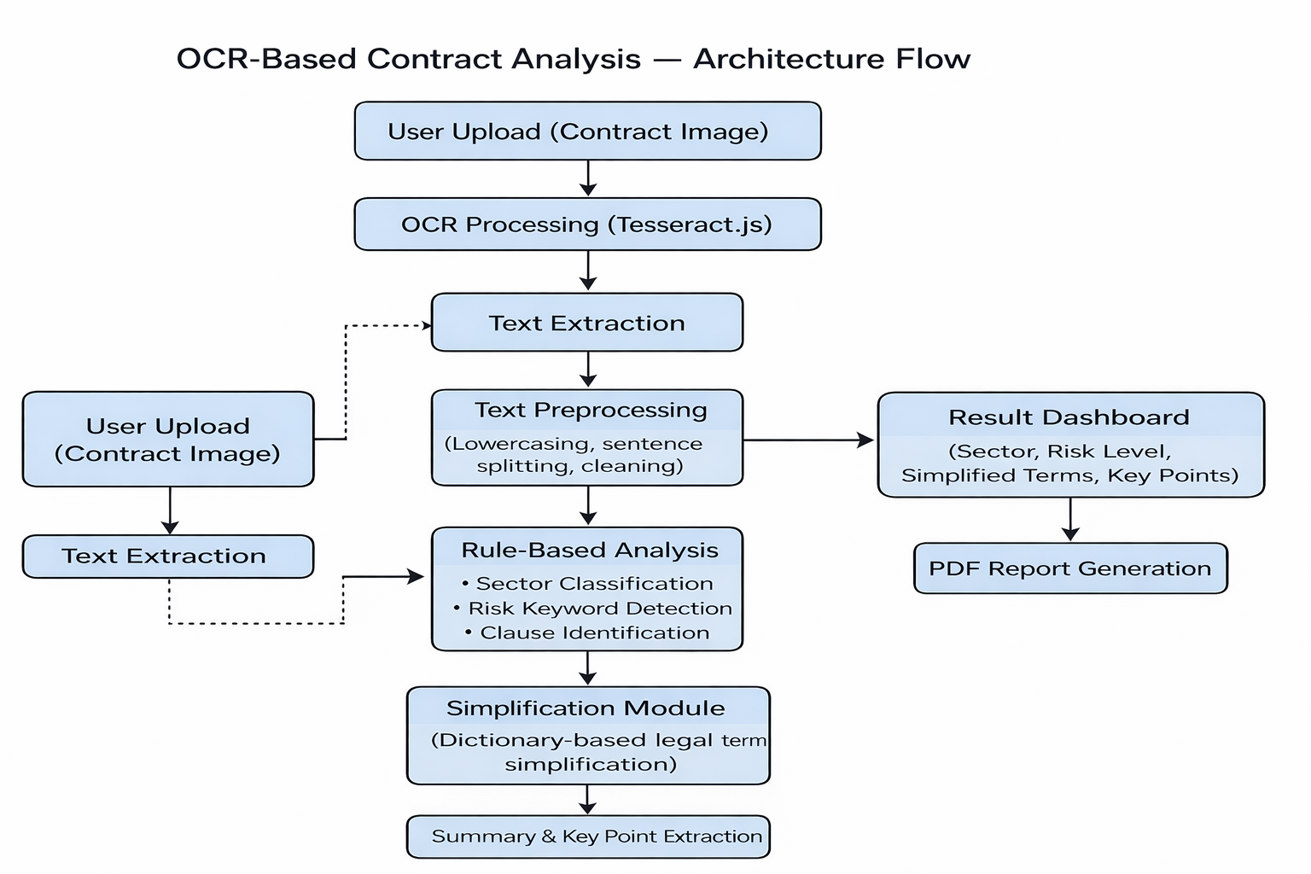
Progress on Design and Analysis

Slide 12
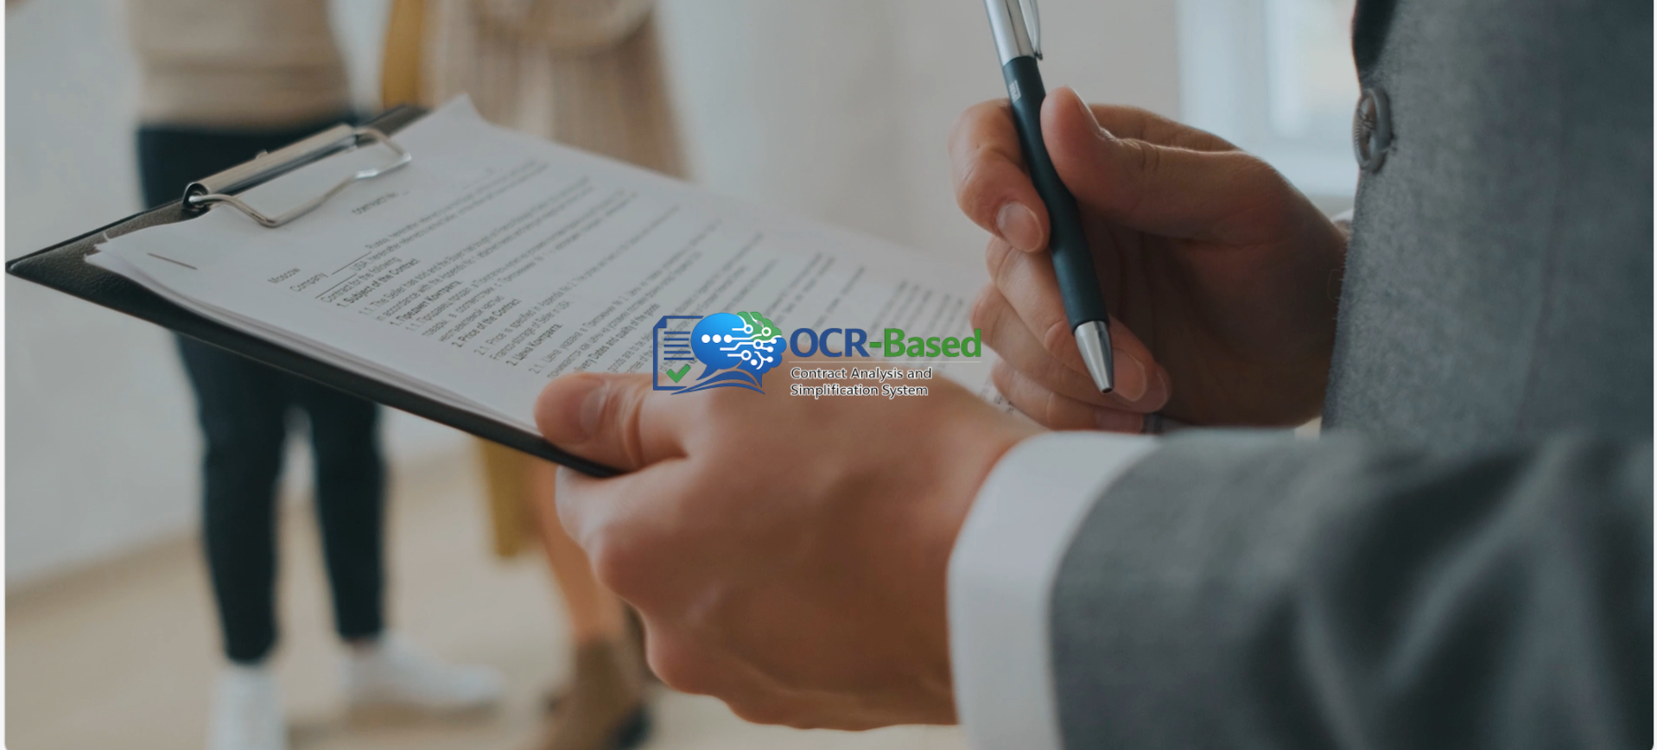
Screenshots

Slide 13
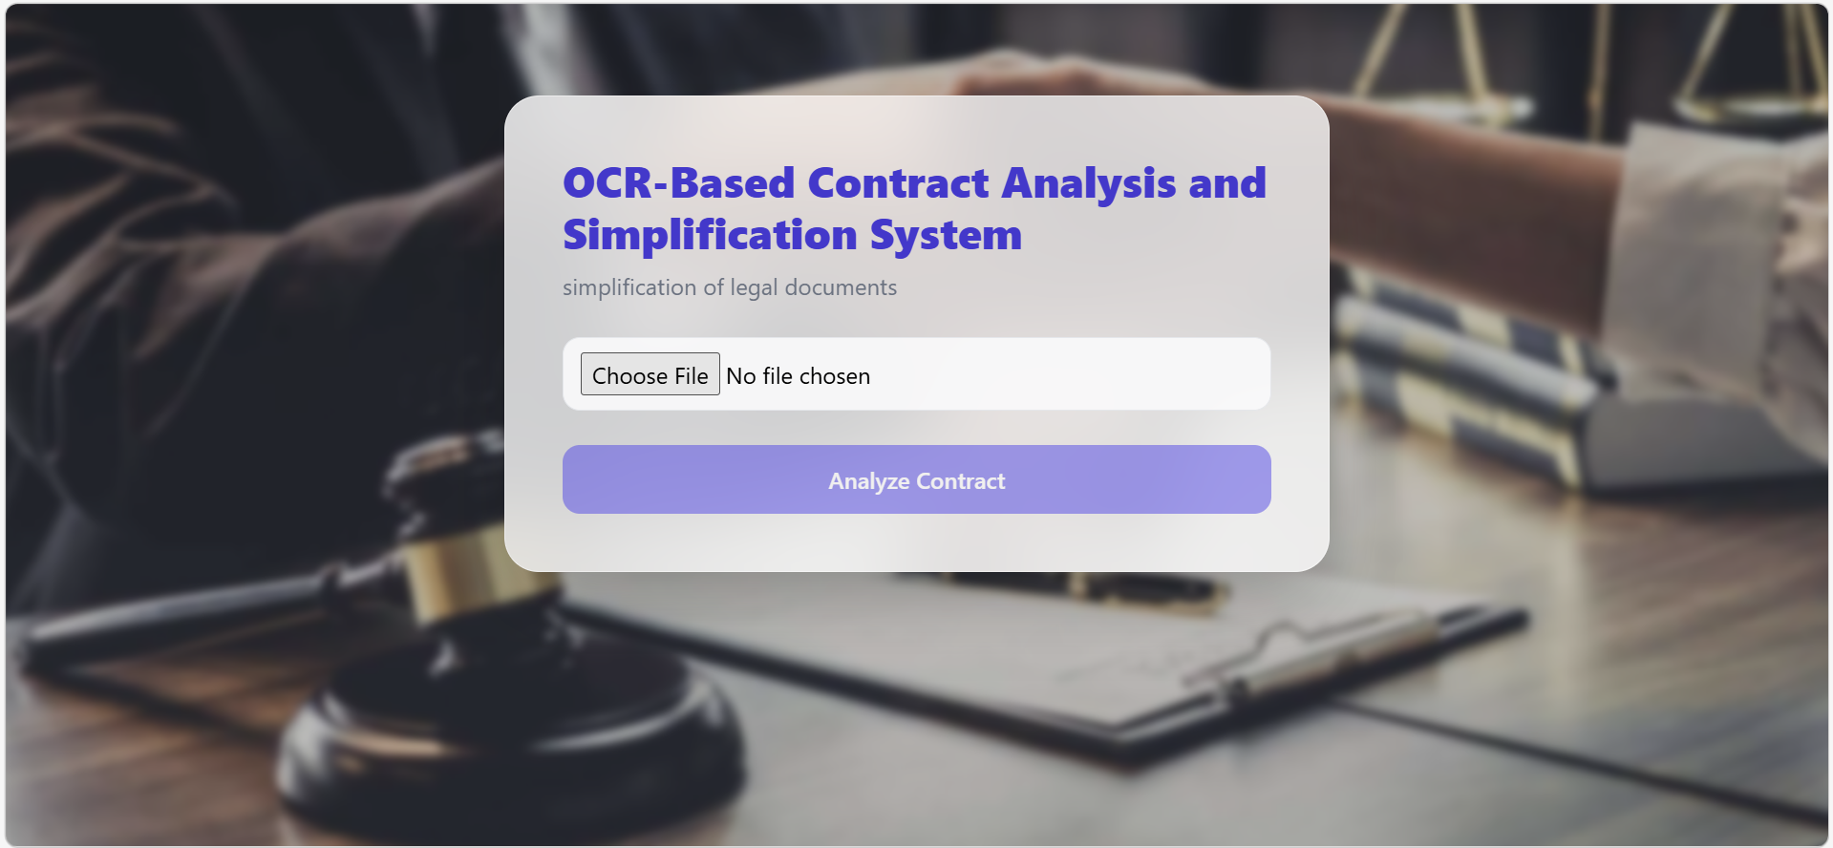

Slide 14
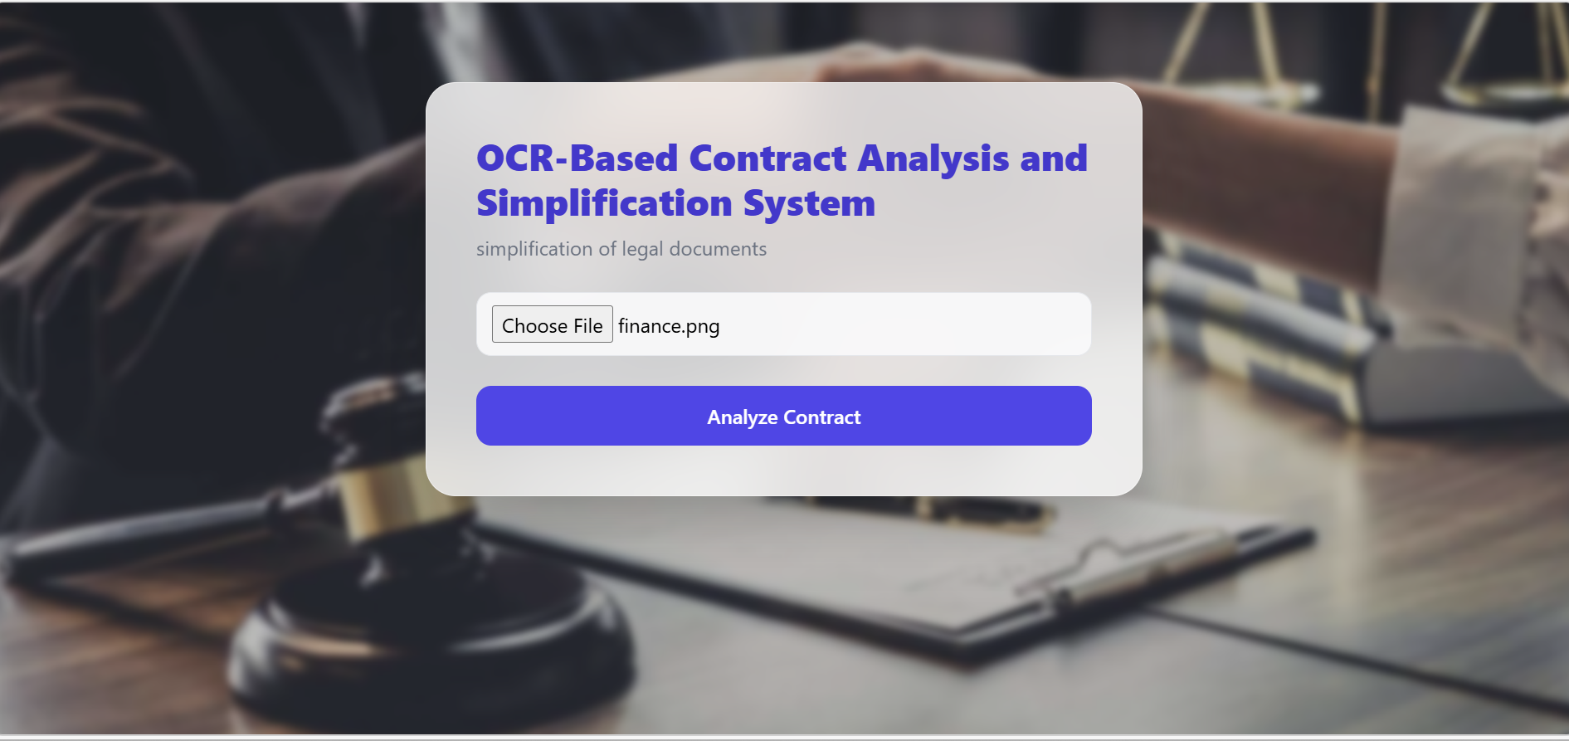

Slide 15
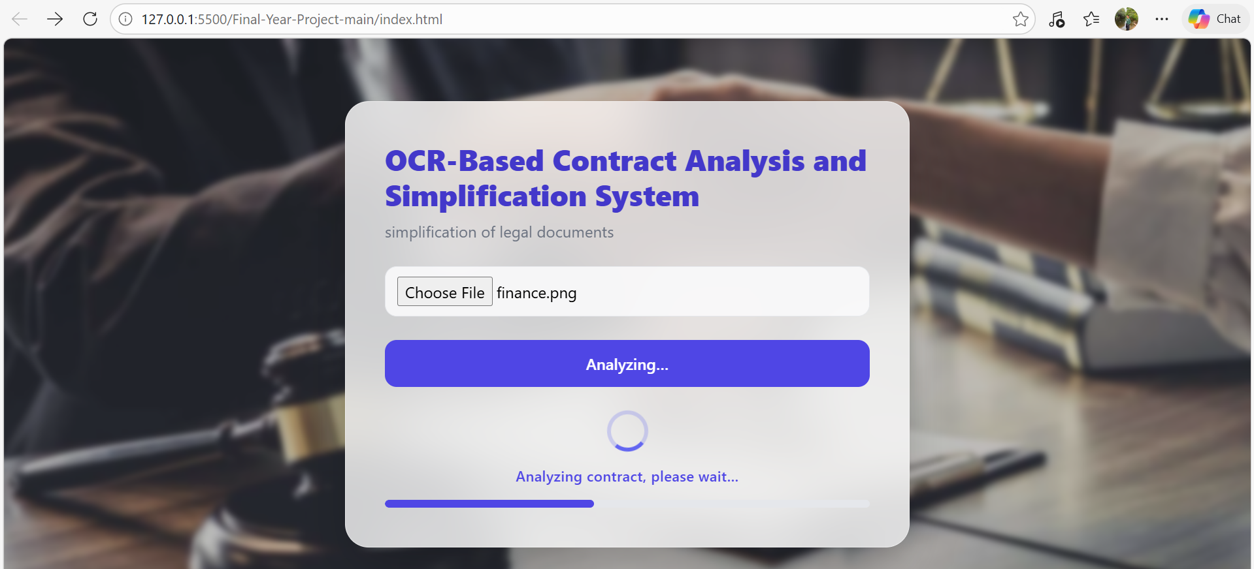

Slide 16
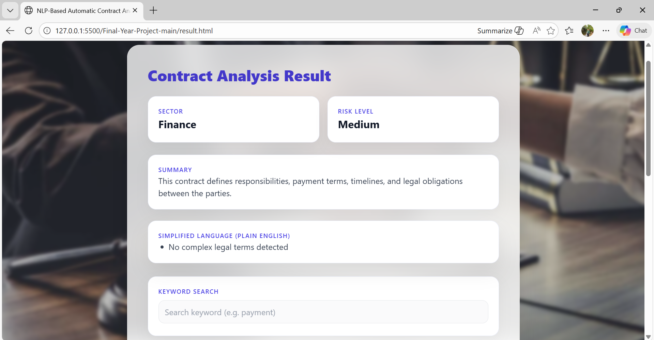

Slide 17
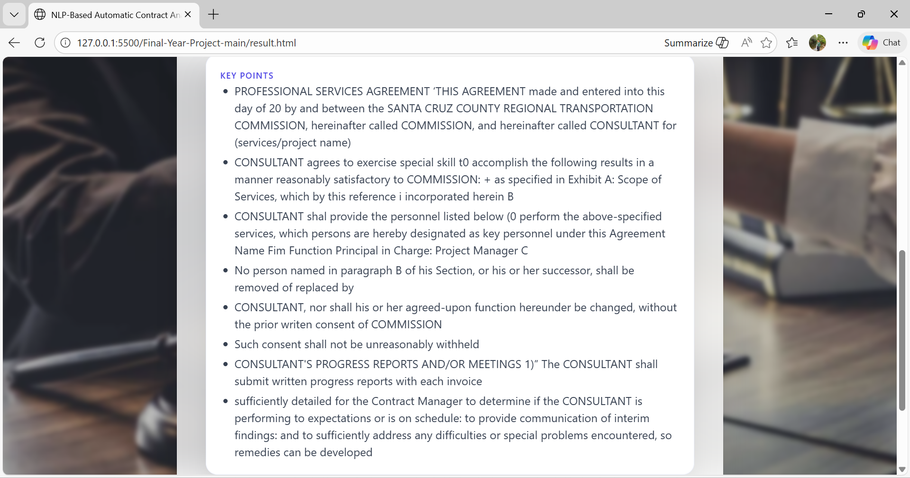

Slide 18
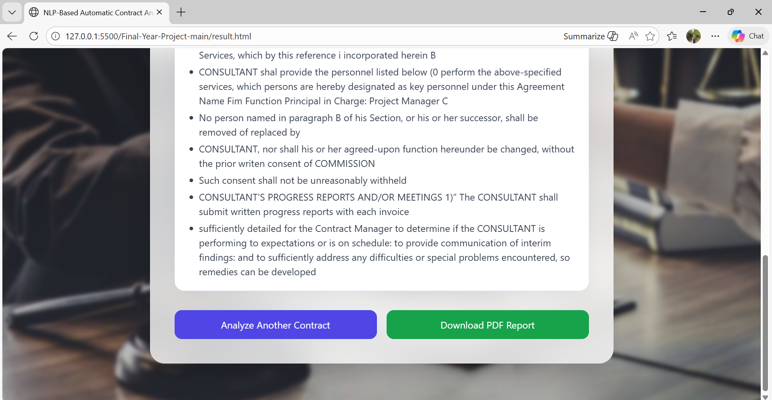

Slide 19
References
[1] R. Smith, “An Overview of the Tesseract OCR Engine,” in Proc. Ninth Int. Conf. Document Analysis and Recognition (ICDAR), 2007, pp. 629–633.
[2] Tesseract OCR Documentation, “Tesseract Open Source OCR Engine.” [Online]. Available: https://github.com/tesseract-ocr/tesseract
[3] Tesseract.js Documentation, “Pure JavaScript OCR for the Browser.” [Online]. Available: https://tesseract.projectnaptha.com/
[4] D. Jurafsky and J. H. Martin, Speech and Language Processing, 3rd ed., Pearson, 2023.
[5] S. Bird, E. Klein, and E. Loper, Natural Language Processing with Python, O’Reilly Media, 2009.
[6] C. D. Manning, P. Raghavan, and H. Schütze, Introduction to Information Retrieval, Cambridge University Press, 2008.

Slide 20
Conclusion
The OCR-Based Contract Analysis and Simplification System successfully demonstrates the practical implementation of Optical Character Recognition (OCR) combined with rule-based text processing for automated legal document analysis. The system converts scanned contract images into machine-readable text, analyzes the extracted content to identify key clauses, classify contract sectors, detect risk-related keywords, and simplify complex legal terminology into plain language. By generating structured summaries and downloadable PDF reports, the system reduces manual effort and improves the accessibility and understanding of legal documents for non-expert users. Overall, the project proves that automated contract analysis can be effectively implemented using lightweight web technologies in an efficient and user-friendly manner.

Slide 21
THANK YOU

